Slide 1
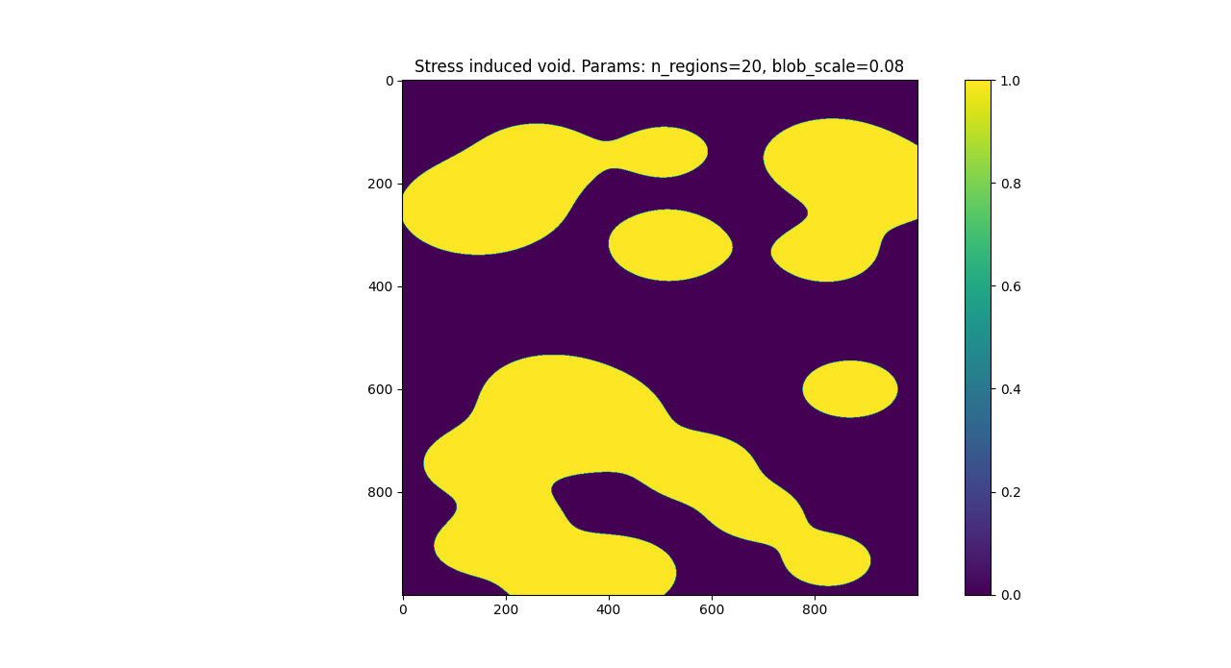

Slide 2
100x

Slide 3
10x

Slide 4

2.5x
Voids near interface
Smaller voids

Slide 5
2x

